Slide 1
Applause
cancellation from music using
deep learning
student Knarik Mheryan
supervisor Vazgen Mikayelyan

Slide 2
Agenda
2. Dataset
1. Problem formulation
3. Pre-
processing
4. Training
procedure
5. Post-
processing
6. Results

Slide 3
1
Problem Formulation

Slide 4

Clean concert audio record from applauses

Slide 5
How represent signal information?

Slide 6
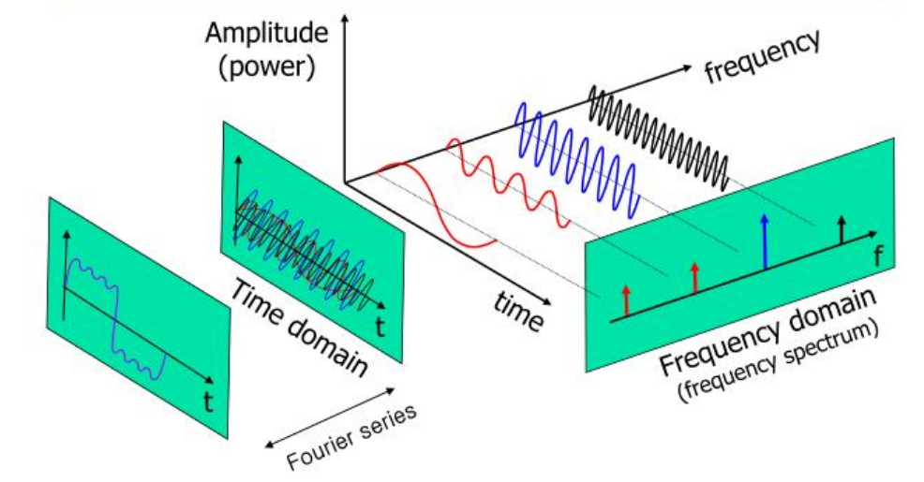
How represent signal information?

Slide 7
How represent signal information?

Slide 8
How represent signal information?

Slide 9
Mathematical Background
FFT
algorithm for getting
spectral information

Slide 10
Mathematical Background
M = | FFT(S) |
Magnitude
FFT
algorithm for getting
spectral information

Slide 11
Mathematical Background
M = | FFT(S) |
Magnitude
FFT
e^{iP} =
FFT(S)
algorithm for getting
spectral information
Phase
M

Slide 12
HOW DO WE DO IT?
mask

Slide 13
HOW DO WE DO IT?
Mask
M_{song}
M_{noisy_song}

Slide 14
HOW DO WE DO IT?
Mask * S_{noisy_song}
M_{song}
M_{noisy_song}
FFT_{estimate}

Slide 15
HOW DO WE DO IT?
Mask * S_{noisy_song}
M_{song}
M_{noisy_song}
IFFT
FFT_{estimate}

Slide 16
HOW DO WE DO IT?
Mask * S_{noisy_song}
M_{song}
M_{noisy_song}
Song_{estimate} =
IFFT
FFT_{estimate}

Slide 17
HOW DO WE DO IT?
Mask * S_{noisy_song}
Pre-processing stage
M_{song}
M_{noisy_song}
Song_{estimate} =
IFFT
FFT_{estimate}

Slide 18
HOW DO WE DO IT?
Mask * S_{noisy_song}
M_{song}
M_{noisy_song}
Training stage
Song_{estimate} =
IFFT
FFT_{estimate}

Slide 19
HOW DO WE DO IT?
Mask * S_{noisy_song}
M_{song}
Post-processing stage
M_{noisy_song}
Song_{estimate} =
IFFT
FFT_{estimate}

Slide 20
Ideal tests for mask!!!

Slide 21
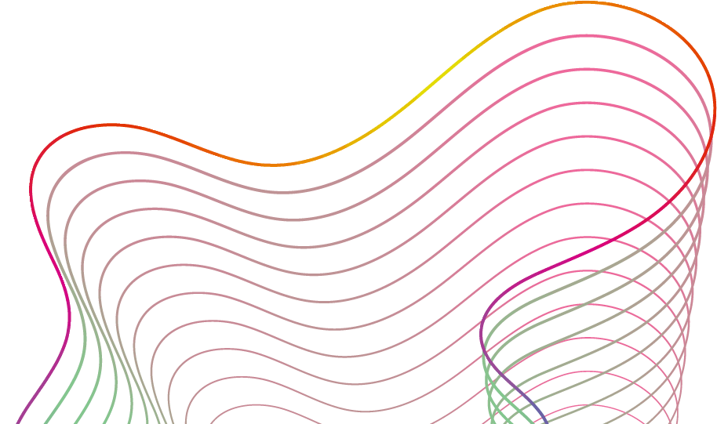
Ideal tests for mask!!!
Dividing
|S_{song}|
|S_{noisy_song}|

Slide 22
Ideal tests for mask!!!
Dividing
|S_{song}|
|S_{noisy_song}|

Slide 23
Ideal tests for mask!!!
Dividing
Clippinig
|S_{song}|
|S_{song}|
k
clip
|S_{noisy_song}|
|S_{noisy_song}|
0
k = {1, 5, 10}

Slide 24
Ideal tests for mask!!!
Dividing
Clippinig
|S_{song}|
|S_{song}|
k
clip
|S_{noisy_song}|
|S_{noisy_song}|
0
k = {1, 5, 10}

Slide 25
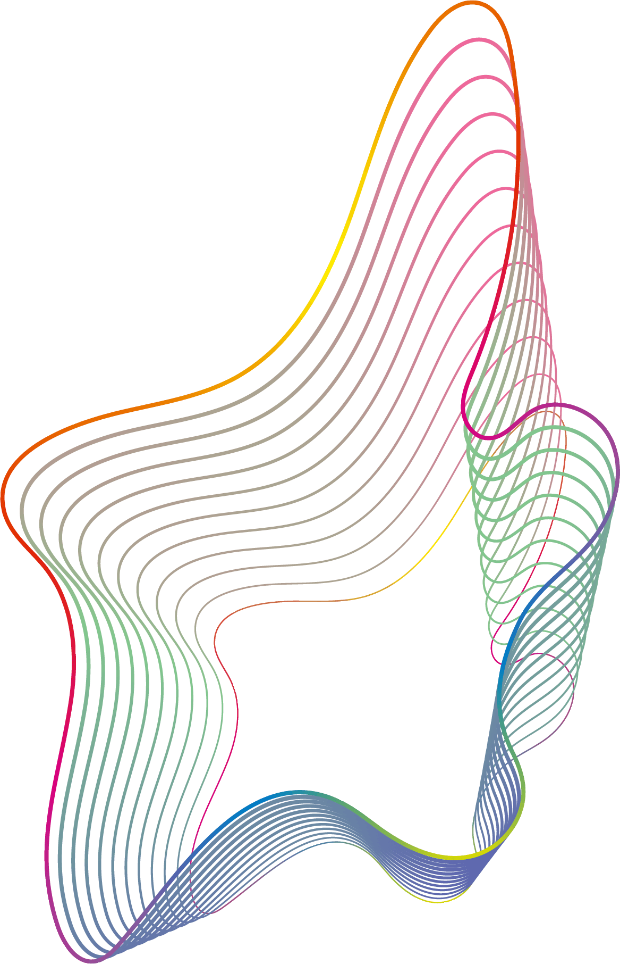
Ideal tests for mask!!!
Dividing
Clippinig
squaring
k
k
|S_{song}|
|S_{song}|
|S_{song}|²
clip
|S_{noisy_song}|
|S_{noisy_song}|
0
|S_{song}|² + |S_{noisy_song} - S_{song} |²
k = {1, 5, 10}
k = {1, 2}

Slide 26
Ideal tests for mask!!!
Dividing
Clippinig
squaring
k
k
|S_{song}|
|S_{song}|
|S_{song}|²
clip
|S_{noisy_song}|
|S_{noisy_song}|
0
|S_{song}|² + |S_{noisy_song} - S_{song} |²
k = {1, 5, 10}
k = {1, 2}

Slide 27
2. Datasets
Musdb18-Hq
150 music tracks (~10h)
different genres
stereophonic
44.1kHz

Slide 28
2. Datasets
Musdb18-Hq
Free sound
150 music tracks (~10h)
different genres
stereophonic
44.1kHz
120 random noises
applause, cheer, clap, laugh, ...
stereophonic
random kHz

Slide 29
3
Pre-processing stage

Slide 30
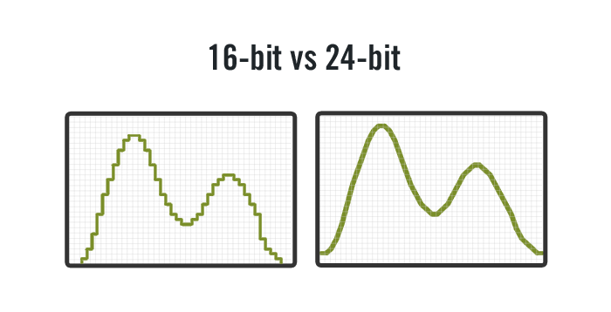
Step 1: Preparing signals
downsample all signals
44.1 kHz

Slide 31
Step 1: Preparing signals
downsample all signals
44.1 kHz
16 kHz

Slide 32
Step 1: Preparing signals
downsample all signals
2. make mono
44.1 kHz
16 kHz

Slide 33
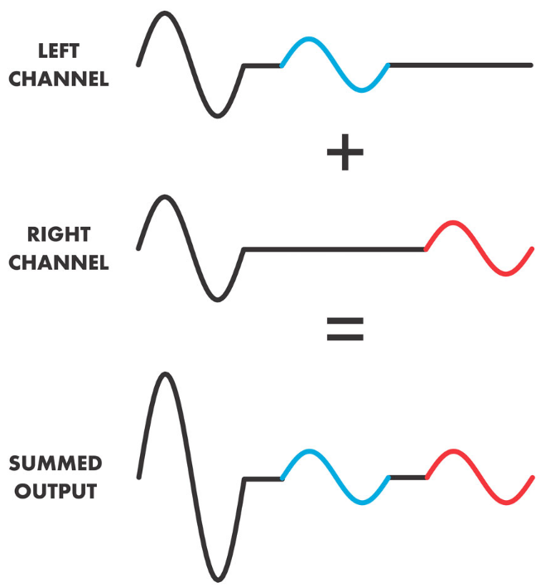
Step 1: Preparing signals
downsample all signals
2. make mono
44.1 kHz
16 kHz

Slide 34
step 2: Framing song signals

Slide 35
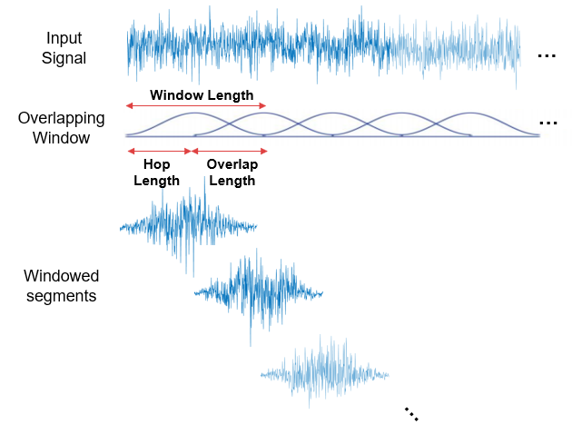
step 2: Framing song signals
5 sec
1sec = 16k points
5sec = 80k points
Vorbis window
2.5 sec

Slide 36

step 3: Making Noisy dataset
songs

Slide 37
step 3: Making Noisy dataset
songs
Noisy songs

Slide 38
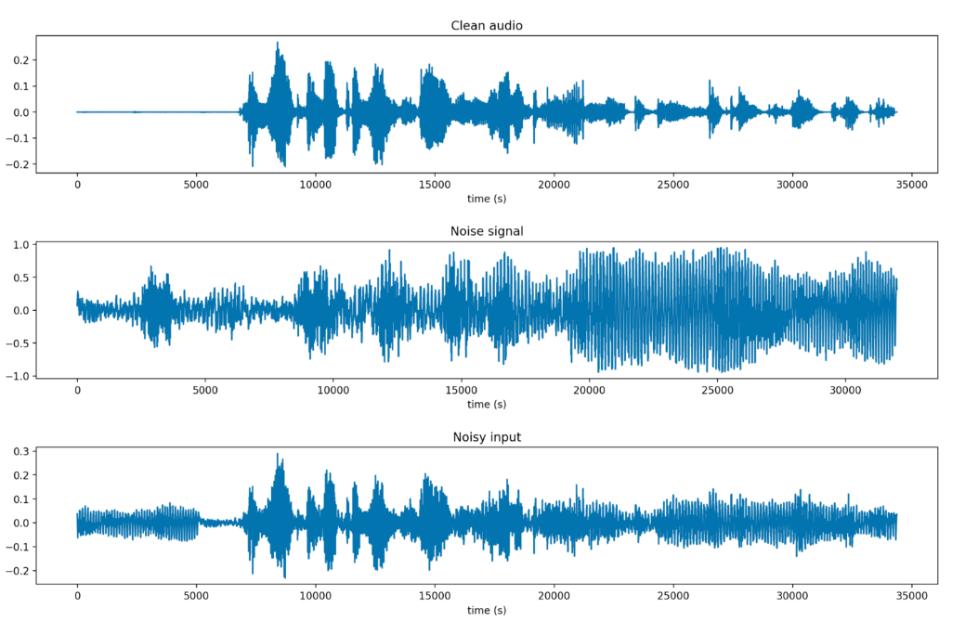
step 3: Making Noisy dataset
songs
Noisy songs

Slide 39
step 3: Making Noisy dataset
songs
Noisy songs
+

Slide 40
step 3: Making Noisy dataset
songs
Noisy songs
+
=

Slide 41
step 3: Making Noisy dataset
songs
Noisy songs
+
=
*
SNR

Slide 42
step 4: Why STFT?

Slide 43
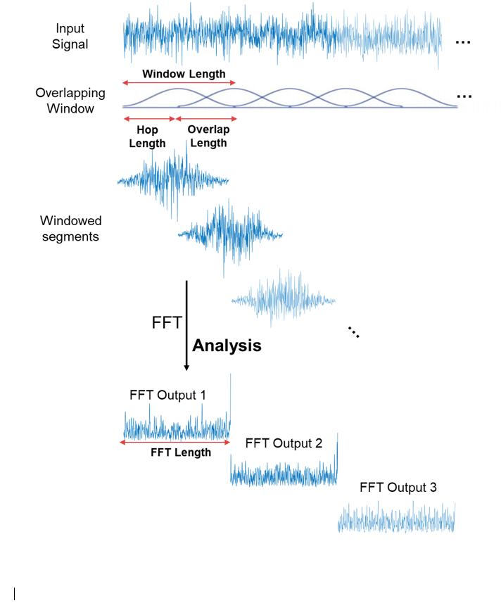
step 4: Why STFT?
30 ms
15 ms
5 sec = 332 frames
Vorbis window
241 coef

Slide 44
4
Training stage

Slide 45
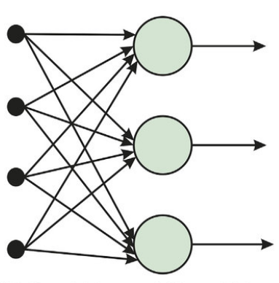
aRCHITECTURE CONSIDERATIONS
FEED-FORWARD
nETWORK

Slide 46
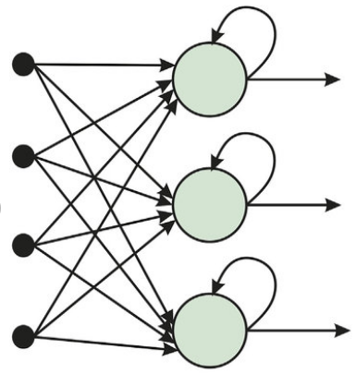
aRCHITECTURE CONSIDERATIONS
FEED-FORWARD
nETWORK
rECURRENT
nETWORK
vs

Slide 47
tRAINING Details
pARAMETER | USED
Architecture | LSTM Bid-GRU
Optimizer | Adam
Learning rate | 0.001
Loss | Frobenius
Data shape | (bs, 332, 241)

Slide 48
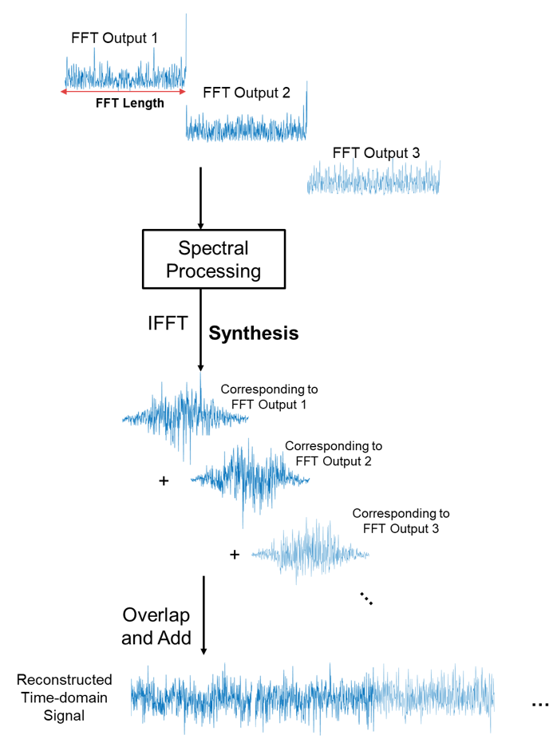
5. Post-processing

Slide 49
5. Post-processing
Estimated song phase = Noisy song phase

Slide 50

Results !!!
Noisy songs
Estimates

Slide 51
Thank you!

